Slide 1



INTRODUCTION TO MULTIMEDIA
IMD316 | WEEK 1
MOHD AKMAL FAIZ OSMAN

Slide 2
COURSE OUTLINE
Define Terms related to Multimedia
Multimedia Components
Uses of Multimedia
Cognitive Theory of Multimedia Learning
Multimedia Equipment
Introduction to Multimedia
1

Slide 3

Terms Related to Multimedia
Multimedia
Interactive Multimedia
Multimedia Developer
Multimedia Project
Multimedia Linear
Multimedia Non-Linear
Multimedia Computer

Slide 4


Multimedia
An integration of text, graphics, audio, animation and video in digital environment
The seamless integration of data, text, image of all kinds and sound within a single digital environment
The use of computer to present and combine text, graphics, audio and video with links and tools that let user navigate, interact, create and communicate

Slide 5
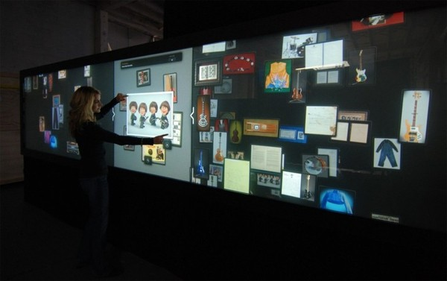
Interactive Multimedia
The multimedia that allow users to browse forward and backward or control on their own.

Slide 6
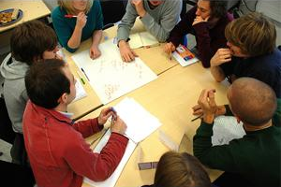
Multimedia Developer
The parties that are responsible in integrating multimedia elements to becoming a useful presentation

Slide 7

Multimedia Project
An application or courseware or message in multimedia form and presented through computer

Slide 8
Multimedia Non-linear
A multimedia presentation that is fully controlled and interactive
Multimedia Linear
A multimedia presentation that presented auto run

Slide 9
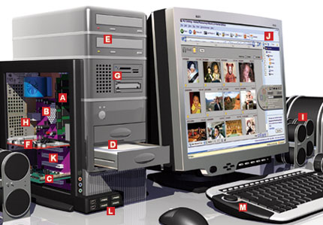

Multimedia Computer
A multimedia computer system is a computer system, which has the capability to integrate two or more types of media (text, graphics, images, audio, and video) for the purpose of generation, storage, representation, manipulation and access of multimedia information.

Slide 10
Multimedia Components
Text
Graphics
Audio
Animation
Video

Slide 11



Text
The actual written characters/words or the form of characters, special symbols, sign
Printed text
Scanned text
Electronic text
Hypertext

Slide 12
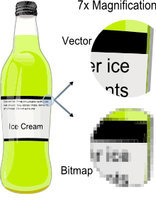

Graphics
The picture or the illustration, drawing or diagram
Bitmaps
Vector images
Clipart
Digitized pictures
Hyper pictures

Slide 13
Audio
Anything involved with hearing and sight. The range of frequencies within human hearing, which is approximately 20Hz at the low end to a high of 20,000Hz.
MIDI – Musical Instruments Digital Interface
Audio CD
CD Plus, CD Extra and Enhanced CD
MP3
Hyperaudio
Sound
Something that can be heard; an audible level of noise.
Notes:
Audio is a more technical term, referring to sound coming from a recording, transmission or electronic device.
Sound is a more generic word and can be caused by any source.
It appears that the word 'audio' is used to specify a particular implementation of a sound, i.e. as in a digitally created sound, whereas 'sound' is the object itself.

Slide 14

Animation
The use of computer to create movement on the screen
Frame Animation
Vector Animation
Morphing
Notes:
"Vector animation" is a term used to refer to animation whose art or motion is controlled by vectors rather than pixels. Vector animation often allows cleaner, smoother animation, because images are displayed and/or resized using mathematical values instead of stored pixel values. One of the most commonly used vector animation programs is Macromedia's Flash.

Slide 15
Video
The motion picture, and the rich and lively resource
Live Video Feeds
Video Tape
Video Disc
Digital Video

Slide 16
Uses of Multimedia
Business
Education
Home
Public

Slide 17


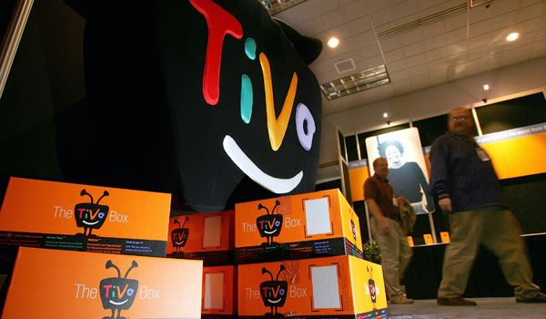

Business
To make business more effective
Presentation
Training
Marketing
Advertisement
Demonstration
Databases
Catalogue
Communication

Slide 18


Education
To change learning process
Encyclopedias
Subjects References
Notes:
In Education, multimedia is used to produce computer-based training courses (popularly called CBTs) and reference books like encyclopedia and almanacs. A CBT lets the user go through a series of presentations, text about a particular topic, and associated illustrations in various information formats. Edutainment is an informal term used to describe combining education with entertainment, especially multimedia entertainment.

Slide 19

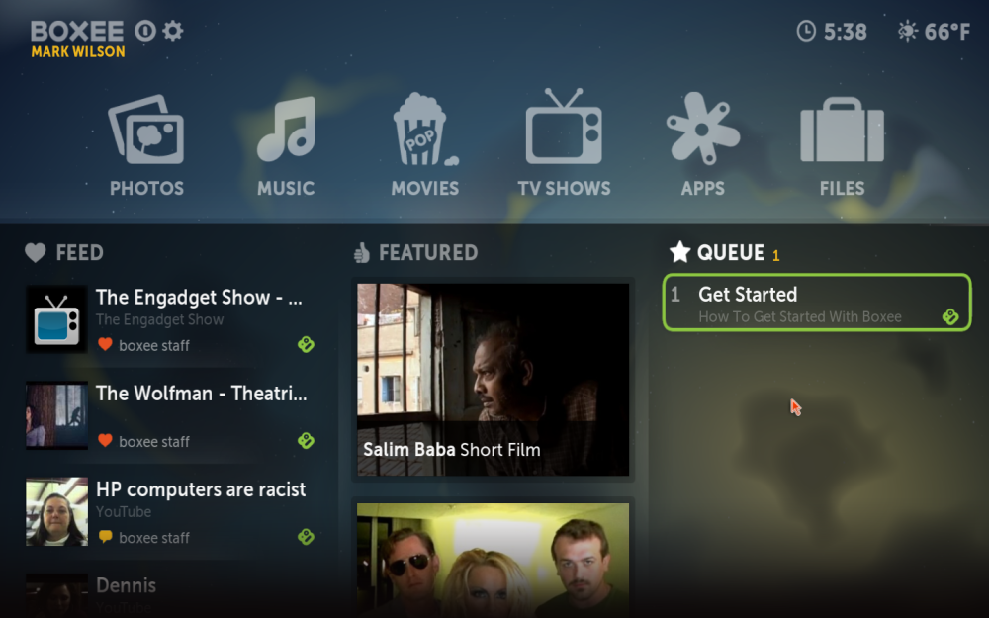
Home
To fulfill daily entertainment needs
Internet
CD-I
Computer Games

Slide 20
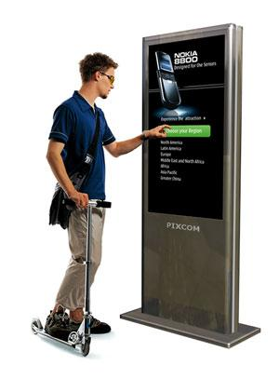

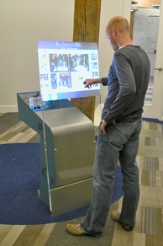
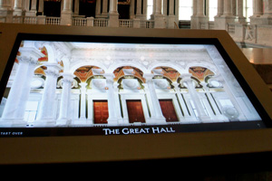
Public
To ensure public facilities
Information kiosk
Booking product
Location map
Current activities
Trip scheduling
Transport guidance

Slide 21
Cognitive Theory of Multimedia Learning
Definition
The cognitive theory of multimedia learning is based on a knowledge-construction view in which learners actively build mental representations in an attempt to make sense out of their experiences

Slide 22
CTML entails how to structure multimedia materials effectively to maximize learning
CTML consists of 12 principles that guide to create effective multimedia presentations for learning
CTML makes three (3) assumptions regarding how human process information :-
Dual-channel assumption
Limited-capacity assumption
Active-processing assumption

Slide 23
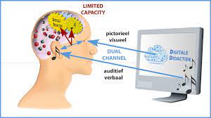
i. Dual-Channel Assumptions
“Humans possess separate channels for processing visual and auditory information”.
The first is the visual–pictorial channel, which processes images seen through the eyes (including words displayed on a screen).
The other channel is the auditory–verbal channel, which processes spoken words

Slide 24
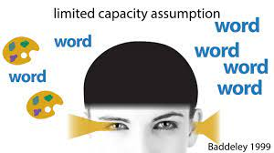
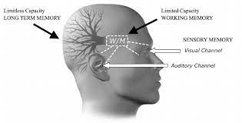
ii. Limited-capacity assumption
Humans have a hard limit on the amount of information they can process at any given moment
E.g. anyone who’s sat in a sports bar and tried to watch several games at the same time or tried to listen to the news while having a conversation.

Slide 25
iii. Active-Processing assumption
Humans don’t learn by just passively absorbing information. Instead, they need to engage in active cognitive processes, namely identifying and selecting relevant material, organizing it into visual and/or verbal models, and integrating those new models with prior knowledge
Words and pictures need to be synthesized into meaningful information that is stored in long-term memory.

Slide 26
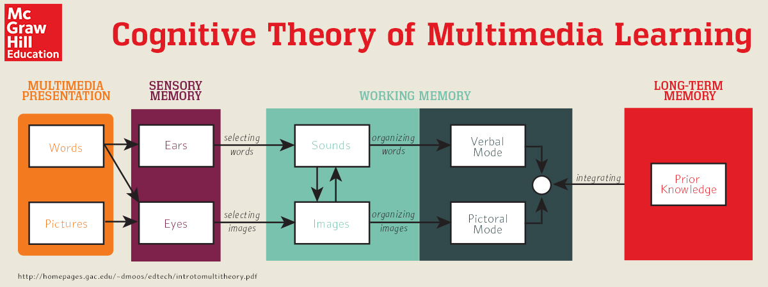

Slide 27
Principles of Multimedia Learning
The Coherence Principle :
“People learn better when extraneous material is excluded”
Instructors should not include information in their multimedia messages that will not be assessed, is merely intended to “spice up” the presentation, or distracts from learning goals overall”
Include only graphics, text, and narration that support learning goals (don’t use decorative images or supplemental materials).
Don’t use background music.
Use simple visuals (as opposed to realistic or detailed visuals).

Slide 28
2. The Signaling Principle :
“People learn better when cues that highlight the
organizational of the essential material are added”
When multiple pieces of information are on-screen, learners need to know what to pay attention to, where they are in the presentation, and how to integrate the information to understand
Instructors should add cues that direct learners’ attention to salient material
Use arrows, highlighting, and other signals to draw attention to important information.
Include an advance organizer (content that presents the organizational structure of your multimedia presentation) and refer back to it when you advance to a new section.

Slide 29
3. The Redundancy Principle :
“People learn better from graphics and narration than some
graphics, narration, and printed text”
Many multimedia presentations involve a combination of spoken words, graphics, and on-screen text. However,
Multimedia messages are most effective when learners encounter just spoken words and graphics.
Text on-screen would risk overwhelming learners’ visual channels with both pictures and words, and inadvertently direct their cognitive processes to resolving differences between the spoken text and the printed text.
When delivering a narrated presentation, use either graphics or text, but not both.
Minimize the use of text during a narrated presentation.

Slide 30
4. The Spatial Contiguity Principle:
“Students learn better when corresponding words and
pictures are presented near rather than far from each other
on the page or screen.”
Instructors should keep text (such as labels or captions) near to the graphics that they describe.
Minimize the cognitive effort that learners must expend to align the meaning of text and images themselves
Place text in close proximity with the graphics it refers to.
Provide feedback close to the questions or answers it refers to.
Present directions on the same screen as an activity.
Have people read any text before beginning an animated graphic.

Slide 31
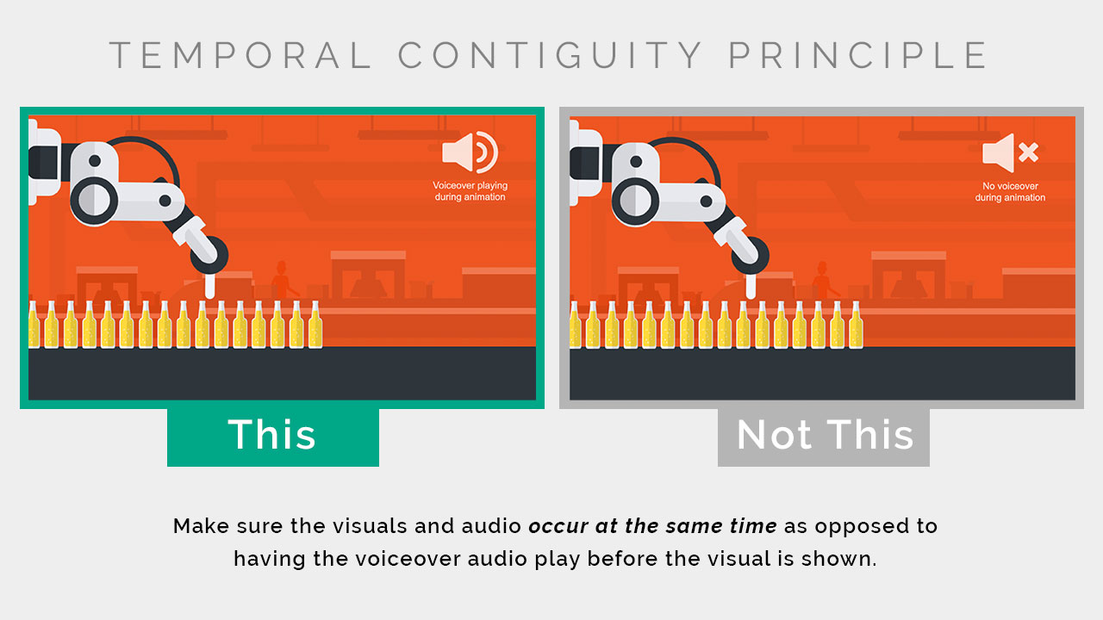
5. The Temporal Contiguity Principle:
“Students learn better when corresponding words and
pictures are presented simultaneously rather than
successively”
Narration and animation should be delivered concurrently
E.g. students shouldn’t hear about a process and then watch an animation of it afterward; instead, instructors should time the narration to play along with the animation
Time narration appropriately to play along with animations

Slide 32
6. The Segmenting Principle:
“People learn better when a multimedia message is
presented in user-paced segments rather than as a
continuous unit.”
Students had the ability to control the pace of the lesson, they performed better on recall and transfer tests
Users should have control over the pace of the multimedia lesson & instructors should chunk material appropriately to allow for adequate processing on each slide or screen.
Allow users to control the pace of the lesson, such as speed controls or “next” buttons.
Break down long segments of material into smaller pieces.

Slide 33
7. The Pre-Training Principle:
“People learn more deeply from a multimedia message
when they know the names and characteristics of the main
concepts..”
Instructors define key terms or concepts before diving into descriptions of processes
Scaffolding learning and helping students establish appropriate prior knowledge before beginning a multimedia lesson.
Define key terms (such as names, definitions, locations, and characteristics) before beginning a process-based presentation, either in a separate presentation, handout, or similar material.
Ensure people know how to use a tool (such as Excel) before asking them to perform learning activities within it.

Slide 34
8. The Modality Principle:
“People learn more deeply from pictures and spoken words
than from pictures and printed words”
Recommends that instructors use narration instead of on-screen text when pictures are present
If multimedia messages contain pictures and on-screen text, the combination may overwhelm learners’ visual channels.
Instead, instructors should only speak words (rather than include them on-screen), which spreads the load across both the visual and the verbal channels
Lists key steps, Provides directions, Provides references,
Presents important information to non-native English speakers

Slide 35
9. The Multimedia Principle:
“People learn better from words and pictures than from
words alone.”
Learners perform better when exposed to words and pictures rather than just words.
Words” in this case should be either printed or spoken, but not both (in keeping with the other multimedia principles).
Effectively leveraging pictures and words together fosters generative processing
Include images to illustrate key points.
Ensure that all images enhance or clarify meaning.
Favor static images over animations (with some exceptionss

Slide 36
10. The Personalization Principle:
“People learn better from multimedia presentations when
words are in conversational style rather than formal style.”
More relaxed tone in an online class can actually positively impact learning
Avoid stiff, academic language, and instead use more approachable colloquial language
Informal language has the effect of creating social cues within the presentation that “prime the activation of a social response in the learner”
Use contractions, Use first and second person (“I,” “you,” “we,” “our,” etc.).
Use polite speech (“please,” “you might like to,” “let’s,” etc.).

Slide 37
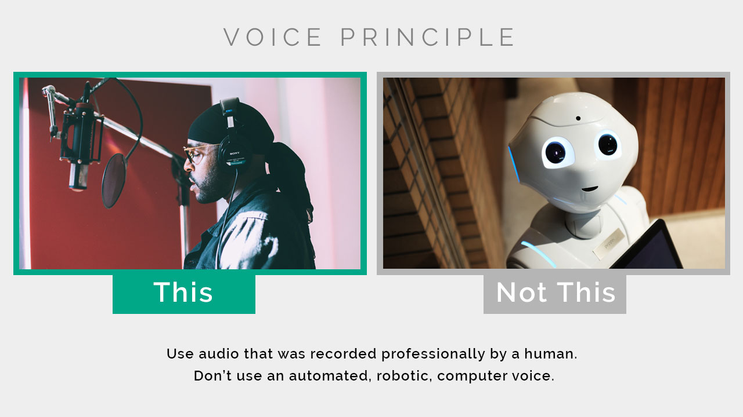
11. The Voice Principle:
“People learn better when narration is spoken in a human
voice rather than in a machine voice.”
Narration is better done by a human than a computer.
Include narration that’s performed by a human rather than a computer.

Slide 38
12. The Image Principle:
“People do not necessarily learn better when the speaker’s
image is added to the screen.”
Image of an instructor’s “talking head” during a multimedia presentation doesn’t necessarily improve learning outcomes.
You don’t necessarily add value by showing your face during a narrated presentation.
Avoid including a video of yourself during an asynchronous multimedia presentation containing pictures and words.
Consider including your face when:
There are no words or pictures.
You wish to establish instructor or social presence

Slide 39
Multimedia Development Equipment
ACTIVITY : DISCUSS THE MULTIMEDIA DEVELOPMENT
EQUIPMENT IN A GROUP OF 3 OR 4 STUDENTS
Computer
Smart Phones
Digital Cameras
Drone
Scanners
Web Cameras
Software

Slide 40
The End of Chapter 1
akmalfaiz@uitm.edu.my
School of Information Science,
College of Computing, Informatics and Mathematics
Universiti Teknologi MARA (UiTM)

